Slide 1
Vue Js

Slide 2
Getting Started With Vue Js
npm run install –g @vue/cli
vue create project_name
cd project_name
npm run serve

Slide 3
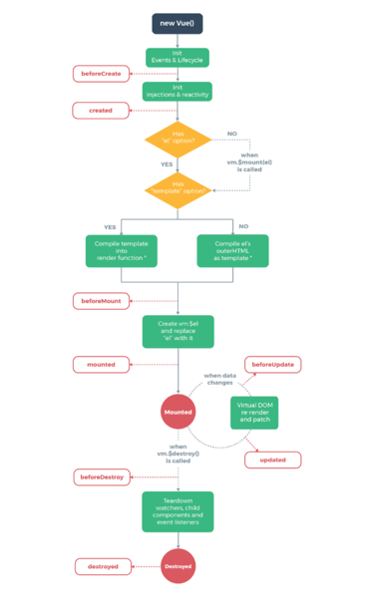
LifeCycle Methods
Methods
beforeCreated
created
beforeMount
mounted
beforeUpdated
Update
beforeDestroyed
destroyed

Slide 4
Uses of Methods
beforeCreated() :- Vue initialize instance’s reactivity and calls the createdHook console.log(‘Before created’, this.list) // Before created undefined
Created() : - Created hook is great time to call ajax call, so it has some time to load before the component is visible to the user. console.log(‘created’, this.list) // Created [array]}
beforeMount() :- Once the virtual DOM is updated vue moves on and updated the real DOM console.log(‘Before mount, this.list) // before mounted [array]}

Slide 5
mounted() :- Here we have access to extra property. This $el property contains the DOM element . We can use it to access the element’s attribute like this.$el.innerText. console.log(‘mounted’, this.list, this.$el) // // mounted [array]}
beforeDestroy() :- whenever you want to turn off event listners like firewall database events this is a best place to do it. console.log(‘mounted’, this.list, this.$el) // // mounted [array]}
destroyed() :- to destroy the instances of the component

Slide 6
If you link the created hook, you can directly execute code as soon as the program starts.
Receive data from child to props
<AddPost v-on:add-post="addPost" />
addPost() {
const newPost = {
title: this.title,
body: this.body
};
//send to parent
this.$emit("add-post", newPost);
(this.title = ""), (this.body = "");
}

